Slide 1

Introduction to AI
A Guide for Travel & Tourism Leaders
Navigating the Transformative Leap in Human Endeavor

Slide 2

Why AI Matters Now
AI is no longer a futuristic concept – it is a transformative technology that caught global attention in 2023.
Our objective: Help business leaders understand opportunities for personalized, seamless, and sustainable travel experiences.

Slide 3
A Brief History of "Thinking Machines"
1956: The term "Artificial Intelligence" is coined at the Dartmouth Conference
1997: IBM Deep Blue beats a chess champion
2011: IBM Watson wins Jeopardy!
2018: AI-generated art begins selling at Christie's auction house
2023: AI featured as lead story across Time, Science, and The Economist

Slide 4
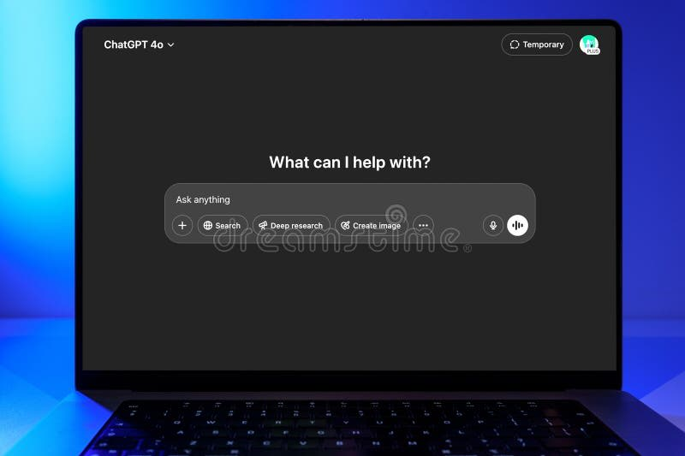
The 2023 Catalyst: ChatGPT
Mass Adoption
ChatGPT reached 100 million users in just 2 months – the fastest-growing consumer product ever.
Mainstream Access
Unlike the supercomputers of the 90s, modern AI is accessible via smartphones and the cloud.

Slide 5
The Three Core Elements of AI
🧠
⛽
⚡
Algorithms
Data
Computing Power
The "Brains" that tell computers what to do
The "Fuel" that tells computers what to learn
The "Machines" that provide the power

Slide 6
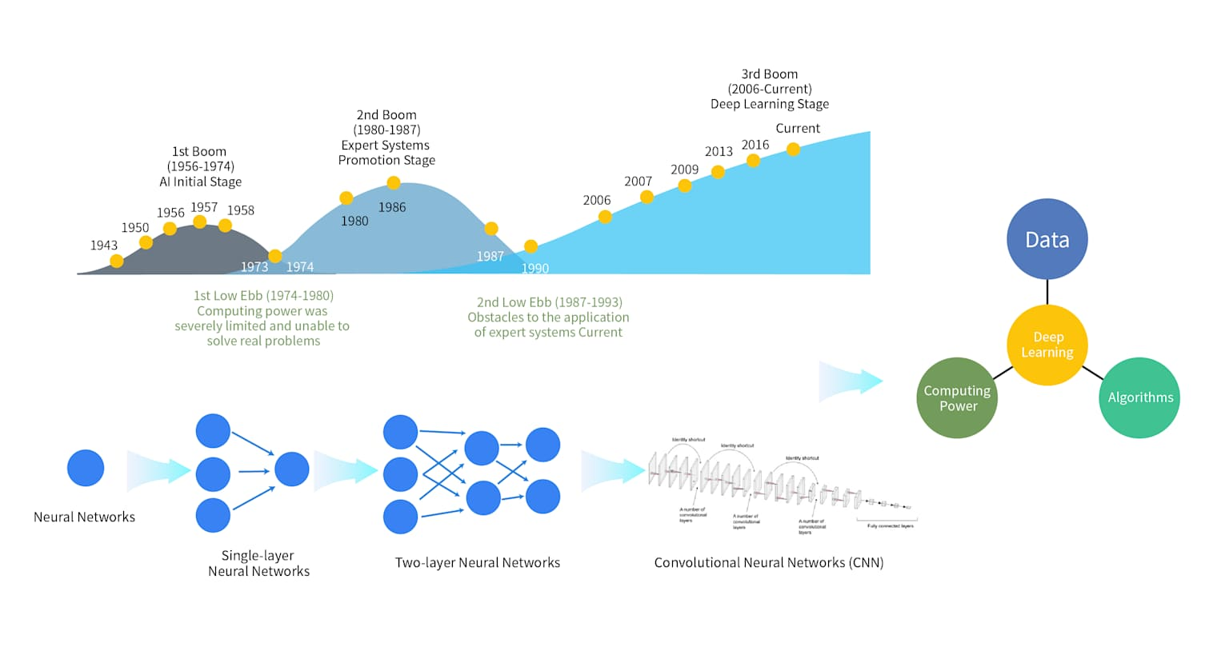
Algorithms: From Rules to Learning
Traditional Programming
Uses "IF-THEN-ELSE" rules (e.g., if fever, then prescribe Drug X)
AI Approach
Systems "learn" from training data to calculate the best route to an outcome without explicit step-by-step coding

Slide 7
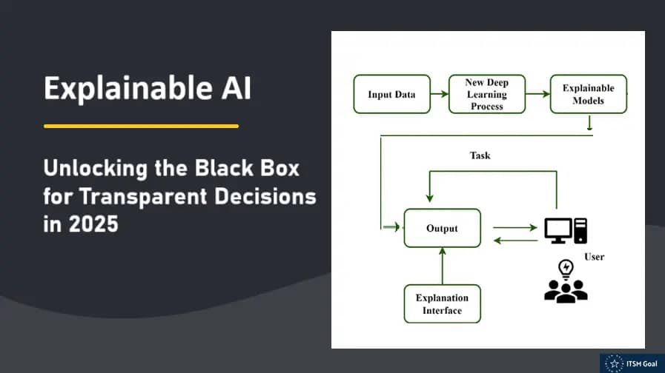
The "Black Box" vs. "Glass Box"
The Challenge: It isn't always possible to know exactly how an AI reached a decision.
Explainable AI: A field dedicated to making AI decisions transparent – turning a "black box" into a "glass box".

Slide 8

Data: The Fuel Driving Innovation
The Explosion: 90% of the world's data was generated in just the last two years.
Scale by 2025: Global data production will reach 175 zettabytes – equivalent to 21 laptops for every person on Earth.

Slide 9
Big Data & The 4 V's
Volume
Velocity
Variety
Massive quantities of information
Incredible speed of data production
Text, images, video formats
Veracity
Ensuring accuracy & reliability

Slide 10
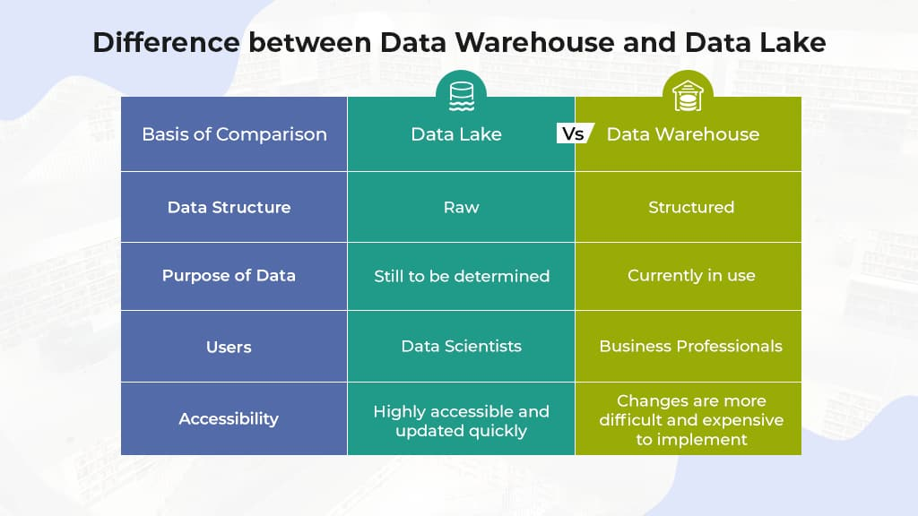
Managing Big Data: Lakes and Warehouses
Data Warehouse
Structured, neatly organized "filing cabinets" (e.g., booking rates)
Data Lake
Unstructured, open repositories for diverse data (e.g., social media posts)
Data Lakehouse
A hybrid solution offering the best of both

Slide 11
Computing Power: The Machines Behind AI
GPU
TPU
Supercomputers
Parallel Processing – Originally for gaming, now essential for AI
Matrix Processing – Google's AI-specific chip
Microsoft's ChatGPT system: 10,000 GPUs

Slide 12
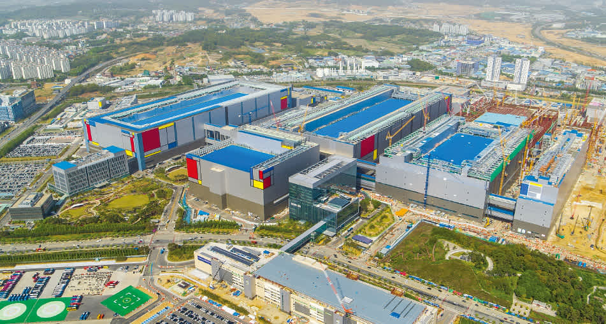
The Geopolitics of AI Chips
Critical Dependence: 70% of the world's chips are manufactured by just TSMC and Samsung
Strategic Investment: Major powers (US, EU, China) are investing billions to secure local supply chains.

Slide 13
Classifying AI: Capabilities
ANI (Narrow)
AGI (General)
ASI (Super)
Designed for one specific task (e.g., spam filters). This is the most common AI today.
Theoretical AI that rivals human intelligence across all areas.
Hypothetical AI that exceeds human intelligence (linked to "Singularity").

Slide 14

Functionality: AI Expert Systems
Role: Simulates human expertise in a specific area, like travel planning.
Mechanism: Combines a Knowledge Base (facts) with an Inference Engine (AI brain).

Slide 15
Functionality: Predictive AI
Purpose: Uses historical data to forecast the future (e.g., flight delays, weather)
Analytics Types
Descriptive: What happened?
Diagnostic: Why did it happen?
Prescriptive: How should we act?

Slide 16
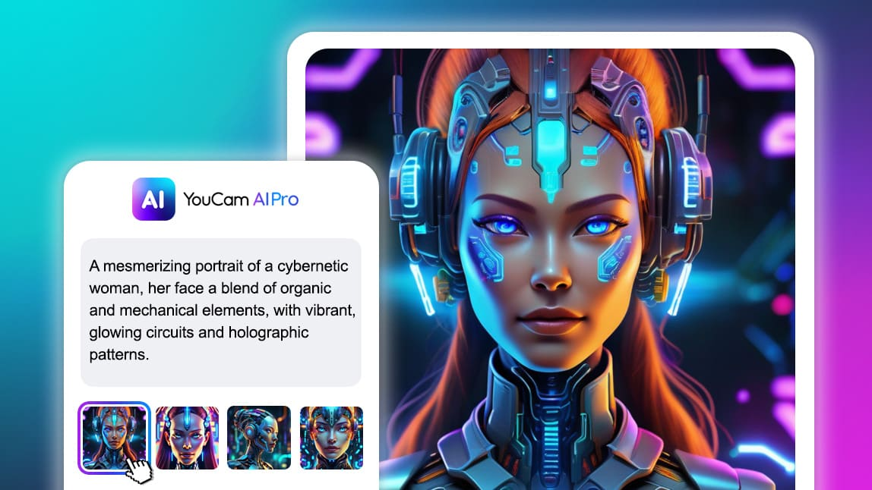
The Rise of Generative AI
Capability: Can produce new content (text, images, audio) from a user "prompt".
Foundation Models: AI trained on broad datasets applicable to many tasks – from code generation to video editing.

Slide 17

Large Language Models (LLMs)
Mechanism: Designed to understand and generate human-like text by learning patterns from massive document collections.
Power: Can translate languages, summarize reports, and draw complex data tables in seconds.

Slide 18
Prompt Engineering & Hallucinations
Prompting
Hallucinations
Action Required
The art of providing clear instructions to guide AI output.
A feature where AI produces convincing but incorrect information.
Business leaders must verify AI outputs for critical operations.

Slide 19
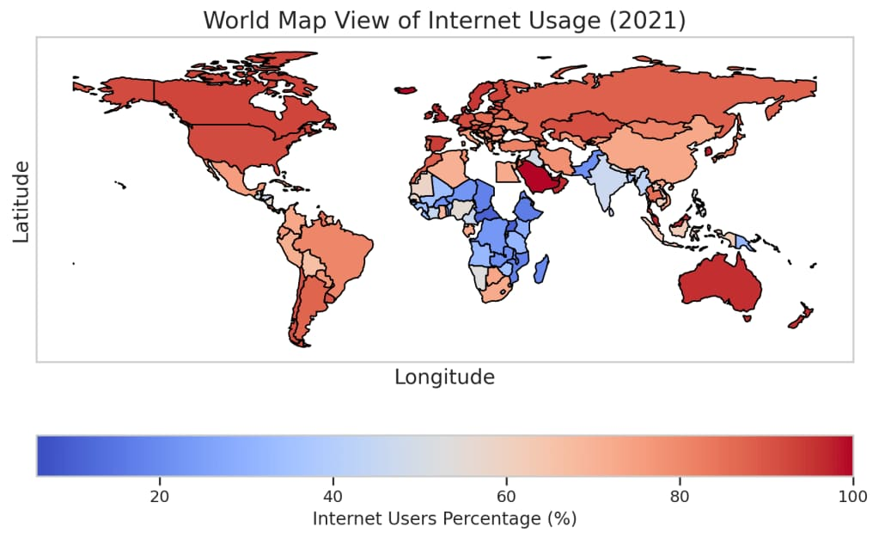
The Global Digital Divide
The Gap: 34% of the world (2.6 billion people) has never been connected to the internet.
Risk: The AI revolution could worsen international inequality if not shared globally.

Slide 20
Closing the AI Skills Gap
20x
13%
✓ Solution
Upskilling through free resources & peer mentoring
Increase in job postings requiring AI skills in 2023
Workers offered AI training
"Mere connectivity is not sufficient" – Doreen Bogdan-Martin, UN ITU Secretary General

